Slide 1
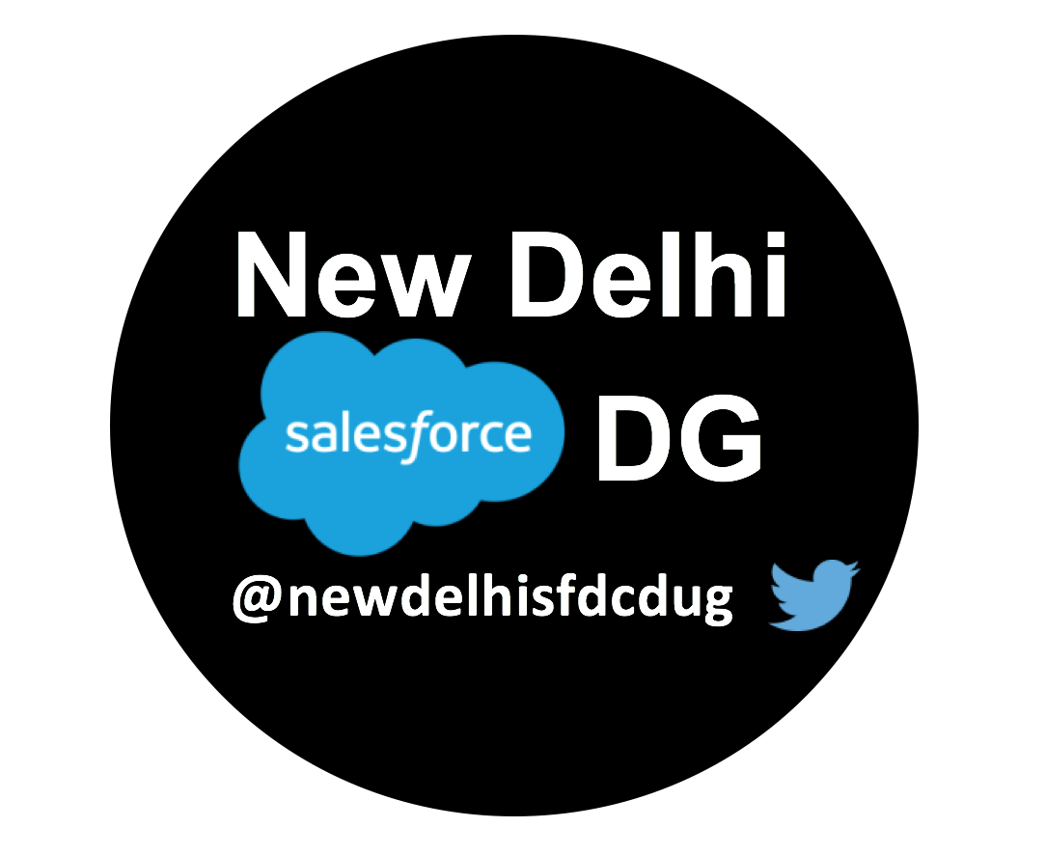




New Delhi Salesforce Developer Group
#ImpactSalesforceSaturday
Mulesoft : Error Handling
LEARN . SHARE . CELEBRATE . SALESFORCE

Slide 2

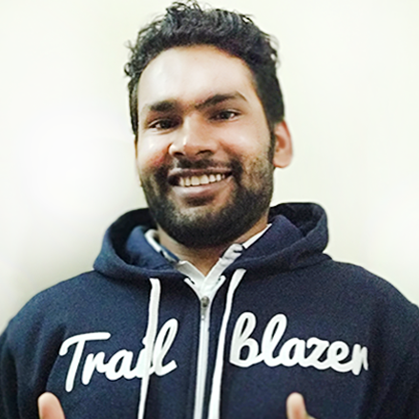




About Me
#ImpactSalesforceSaturday
Amit Singh ( Application Architect )
https://www.linkedin.com/in/simplyamit/
@cloudyamit
www.sfdcpanther.com
https://trailblazer.me/id/sfdcamit

Slide 3
About New Delhi Salesforce DG
#ImpactSalesforceSaturday
First Revival Meetup in February 2016
Twitter: https://twitter.com/newdelhisfdcdug
New Delhi Salesforce DG Trailblazer Community Group: http://bit.ly/NewDelhiCommunity
Facebook: https://www.facebook.com/newdelhisfdcdug

Slide 4
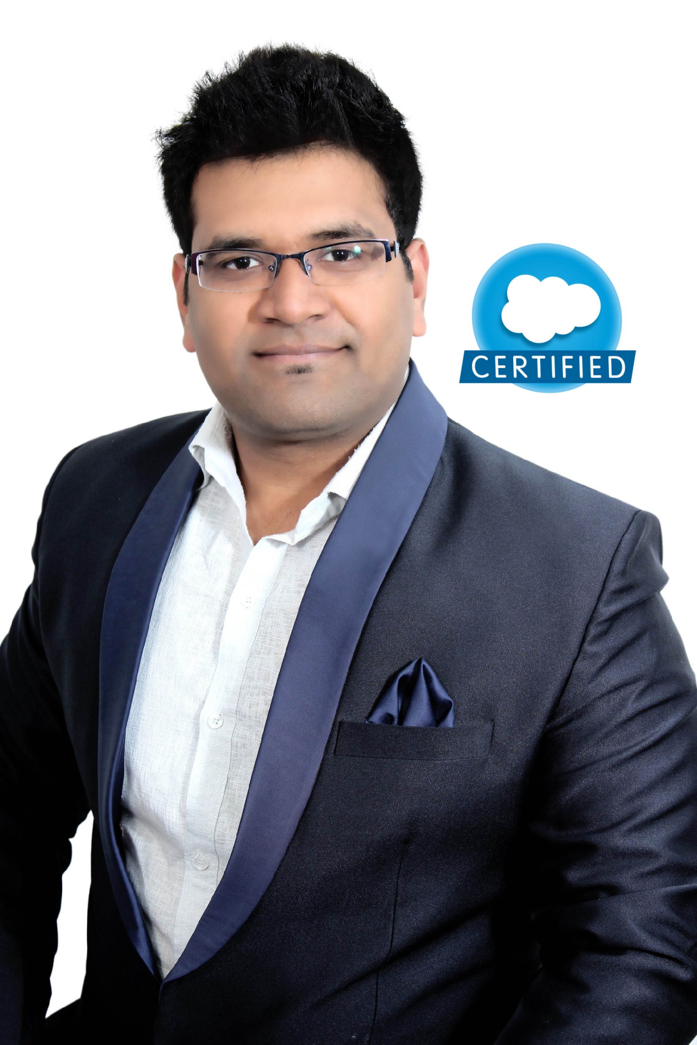
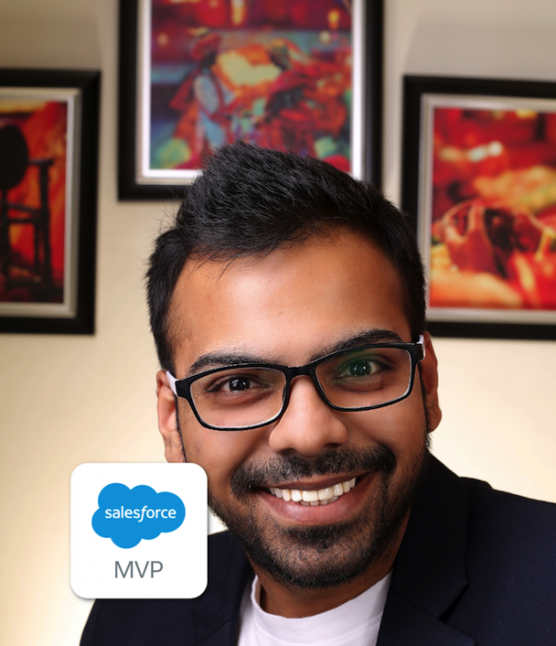


Meet New Delhi Leaders
Atul Gupta
8X Certified
Salesforce MVP
Founder, CEO of CloudVandana Solutions
Community Manager at MentorshipCentral
More than 8 years of experience working in Salesforce domain
Author of “Salesforce Platform Developer I (Apex & Visualforce) Certification Training” live on Simplilearn
Nitin Gupta
8X Salesforce Certified
Sales Cloud Consultant | Pardot Consultant | Marketing Cloud Consultant
Speaker | Blogger
New Delhi Salesforce Developer Group Leader
#ImpactSalesforceSaturday

Slide 5

Agenda
#ImpactSalesforceSaturday
Mule Event
Conditional routing of request
Error Handling
Global ( Application )
Application ( Flow )
Process Level
Summary
Q & A

Slide 6
Mule Event Structure
#ImpactSalesforceSaturday
Mule Events contains the core information that passes
Runtime.
The Data that passes through
Flows in the app
Mule Event
Attributes
The metadata contained in the
message header
Payload
The Core info of the message
The metadata that can
Be defined & referenced
in the app
Variables

Slide 7
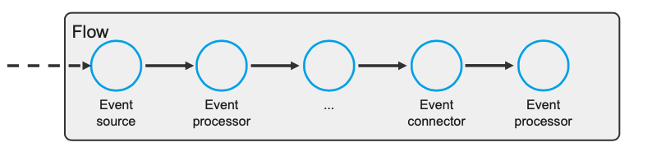
Mule Event Structure
#ImpactSalesforceSaturday
Note that the Mule event is immutable, so every change to an instance of a Mule event results in the creation of a new instance.
Mule Event
Attributes
Payload
Variables

Slide 8
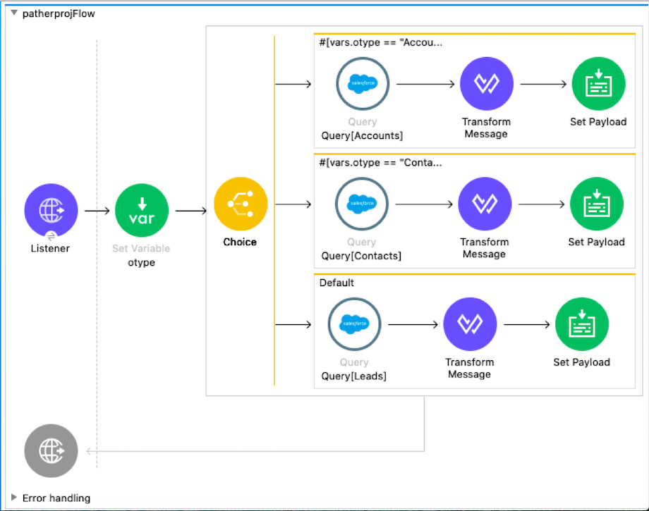
Conditional routing of the Event
#ImpactSalesforceSaturday

Slide 9
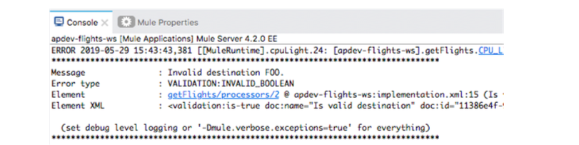
Mulesoft : Default Error Handling
#ImpactSalesforceSaturday
If there is no Error handler is defined “mulesoft default error handler is used”
Globally handles all the message or error thrown in the mule Application
Stops the Execution of the flow and logs information about the error
Cann’t be configured

Slide 10
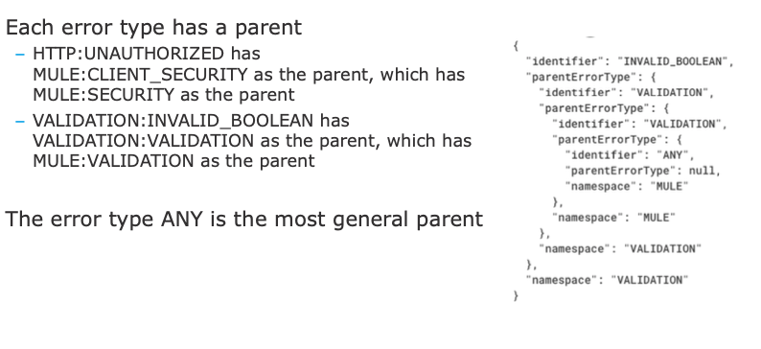
Mulesoft : Default Error Handling
#ImpactSalesforceSaturday

Slide 11

Information returned from HTTP listeners
#ImpactSalesforceSaturday
By default for a Success response returned
The payload
The status code of 200
By default for an Error response returned
The error description
The Status code of 500
These values can be override for a HTTP listener

Slide 12
Mulesoft : Global Error Handler
#ImpactSalesforceSaturday
Each Error handler can contain one or more error handler scope
On Error Continue
On Error propagate
Each error scope can contain any no of scope processors

Slide 13
Mulesoft : Error Handler Scenario 1
#ImpactSalesforceSaturday
Error Response Returned
callingFlow
Http
E
P
Error gets thrown
Request
Error Occurred
Subsequent processors
NOT Executed
Mulesoft Error Handler Executed
No Error Handler
Error gets thrown

Slide 14
Mulesoft : Error Handler Scenario 2
#ImpactSalesforceSaturday
Success Response Returned
callingFlow
Http
E
P
On Error Continue
Scope Executed
Request
Error Occurred
Subsequent processors
NOT Executed
On Error Continue Scope
Error gets thrown

Slide 15
Mulesoft : Error Handler Scenario 3
#ImpactSalesforceSaturday
Error Response Returned
callingFlow
Http
E
P
On Error Propagate
Scope Executed
Request
Error Occurred
Subsequent processors
NOT Executed
On Error Propagate Scope
Error gets thrown

Slide 16
Mulesoft : Error Handler Scenario 4
#ImpactSalesforceSaturday
callingFlow
Success Response Returned
Http
FR
P
Request
Flow Referenced
Child Flow
Subsequent processors
NOT Executed
On Error Propagate
Error gets thrown
On Error Continue Scope
childFlow
On Error Propagate
Http
E
P
Request
Error Occurred
Subsequent processors
NOT Executed
Error gets thrown
On Error Propagate Scope

Slide 17
Mulesoft : Handling Error at Flow Level
#ImpactSalesforceSaturday
If flow has an Error handler
The error is handled by the first error scope whose conditions are true
If no scope are true, the error handled by the default error handler
If a flow does not have any Error handler
The Error is handled by the application level default error handler

Slide 18
Mulesoft : Error Handler Scenario 5
#ImpactSalesforceSaturday
Error Response Returned
callingFlow
Http
E
P
Error gets thrown
Request
Error Occurred
Subsequent processors
NOT Executed
Mulesoft Error Handler Executed
No Error Handler
Error gets thrown
Application default error handler - with a matching scope condition

Slide 19
Mulesoft : Error Handler Scenario 6
#ImpactSalesforceSaturday
Error Response Returned
callingFlow
Http
E
P
Error gets thrown
Request
Error Occurred
Subsequent processors
NOT Executed
Mulesoft Error Handler Executed
On Error Propagate 1 w/o match
On Error Continue 1 w/o match
Error gets thrown
Application default error handler - with a matching scope condition

Slide 20
Mulesoft : Handling Error at Processors Level
#ImpactSalesforceSaturday
Error handling behaviour in the try scope
On Error Propagate
All processors in the error handlers are executed
At the end of the scope
The rest of try scope are not executed
If transaction is being handled it is rolled back
An HTTP Listener returned an error response
On Error Continue
All processors in the error handlers are executed
At the end of the scope
The rest of try scope are not executed
If transaction is being handled it is committed
An HTTP Listener returned a successful response

Slide 21
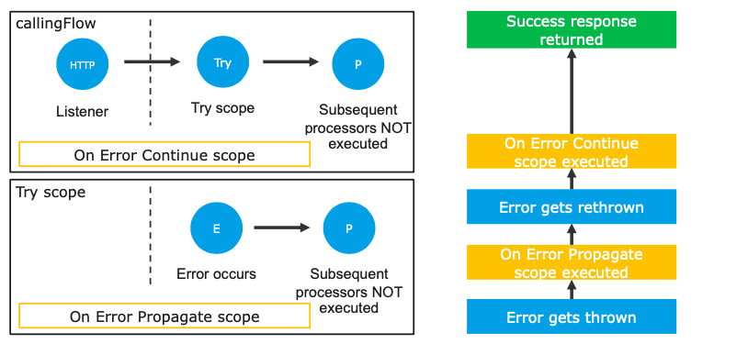
Mulesoft : Error Handling Scenario
#ImpactSalesforceSaturday

Slide 22
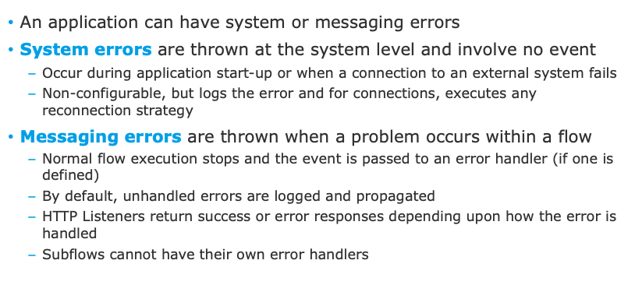
Mulesoft : Summary
#ImpactSalesforceSaturday

Slide 23
Follow Me
#ImpactSalesforceSaturday
Amit Singh
https://www.linkedin.com/in/simplyamit/
@cloudyamit
www.sfdcpanther.com
https://trailblazer.me/id/sfdcamit

Slide 24
Follow & Join New Delhi Salesforce DG
#ImpactSalesforceSaturday
Join to know about future events and to RSVP: https://trailblazercommunitygroups.com/delhi-in-developers-group/
Let’s start conversations on Success Community: http://bit.ly/NewDelhiCommunity
Follow us on Twitter: https://twitter.com/newdelhisfdcdug
Follow us on Facebook: https://www.facebook.com/newdelhisfdcdug
For all the content: https://newdelhisfdcdug.com

Slide 25
Thank You
#ImpactSalesforceSaturday

